Slide 1
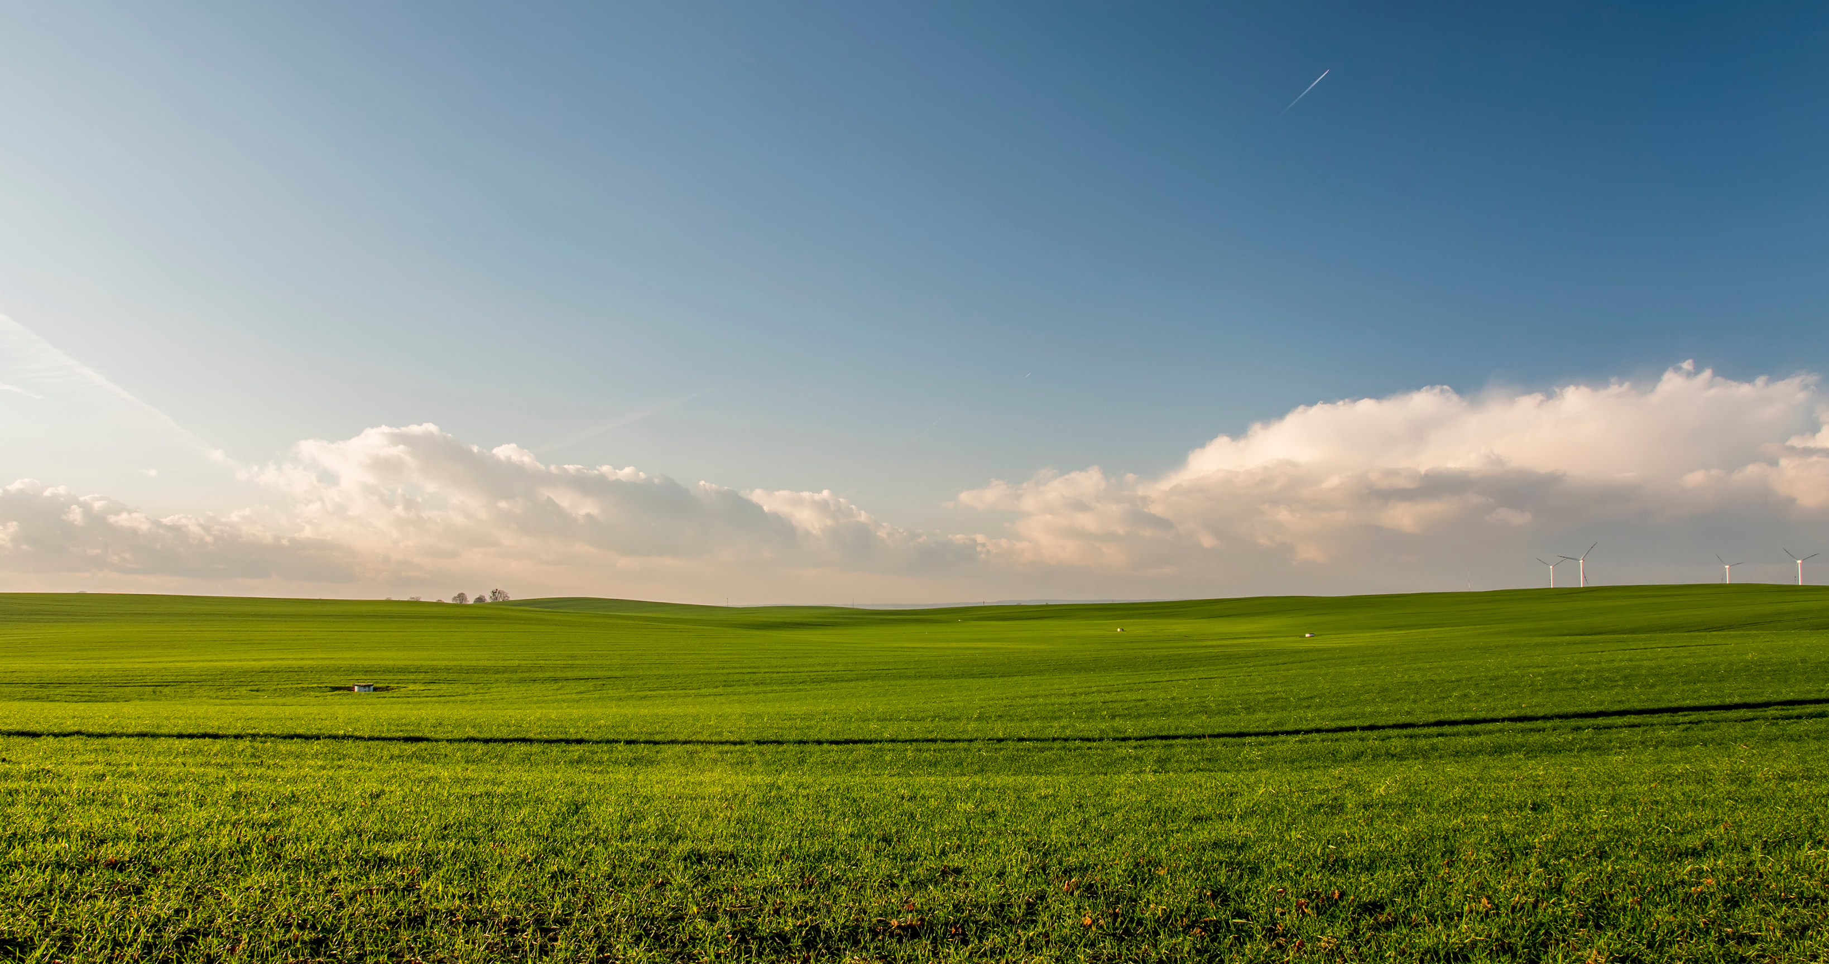


AGROSMART
SMART FARMING DASHBOARD
presented by:
Vishal Baraiya

Slide 2
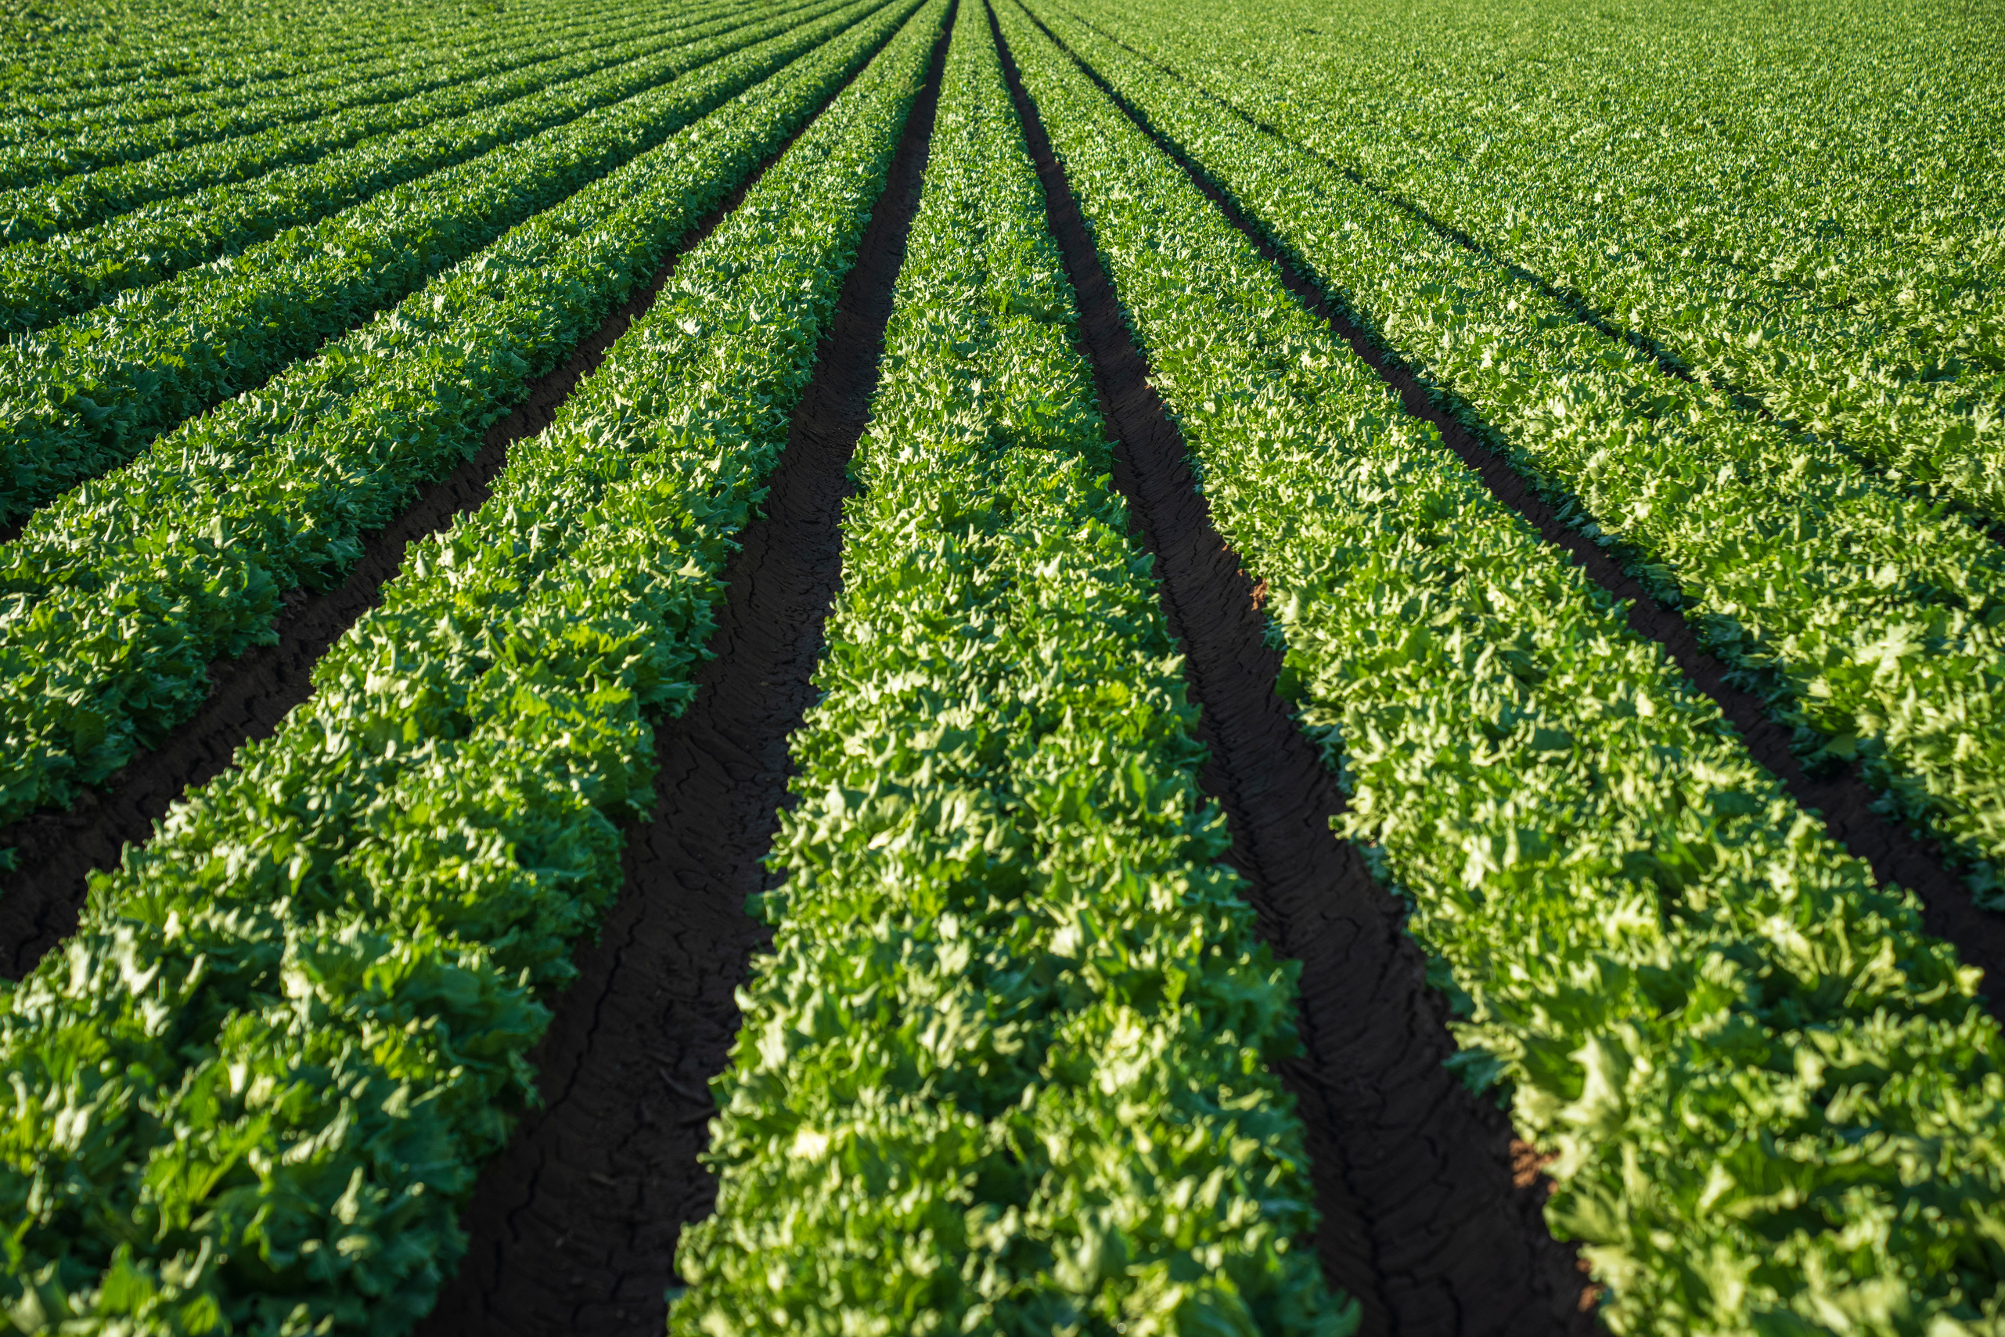

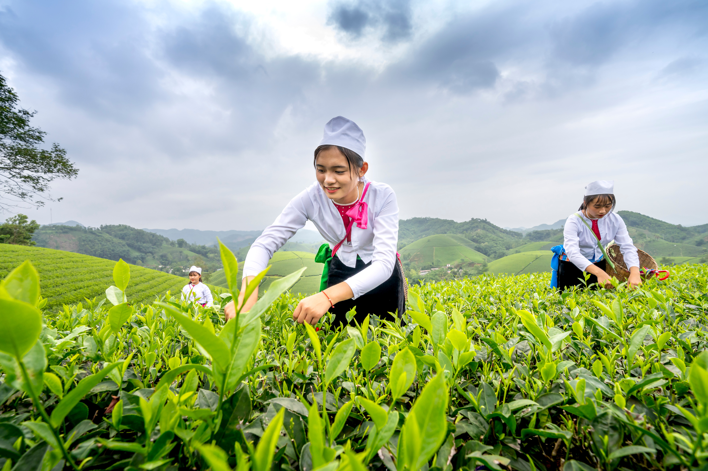
02
About Us
Mission Statement : To empower farmers with smart, data-driven solutions that enhance productivity, optimize resources, and promote sustainable agriculture through technology and innovation.
Values:
Innovation
Harnessing modern technologies (IoT, AI, Data Analytics) to transform agriculture into smart farming.
Sustainability
Promoting eco-friendly practices to conserve water, soil, and energy.
Empowerment
Providing farmers with accessible tools to make informed decisions.
Collaboration
Building a strong connection between farmers, researchers, and technology providers.
Integrity
Ensuring transparency, trust, and reliability in our solutions.
Impact
Driving measurable improvements in yield, efficiency, and farmer livelihoods.

Slide 3
03
AgroSmart – Tech Stack
Authentication & Security
JWT (JSON Web Token) → Secure user login & role-based access
Frontend (User Dashboard)
React.js → Interactive, component-based UI
Tailwind CSS+ Framer Motion → Modern design + smooth animations
EmailJS → Send emails directly from dashboard (e.g., Contact Us, Notifications)
Hosting: Netlify (fast global CDN)
Backend (APIs & Business Logic)
ASP.NET Core Web API → RESTful services
Entity Framework Core → ORM for MS SQL
Hosting: Render (backend deployment)
Database (Data Storage)
Microsoft SQL Server
Hosting: Azure SQL Database (scalable, secure, reliable)
Supporting Tools
GitHub → Version control & collaboration
Postman → API testing & validation

Slide 4
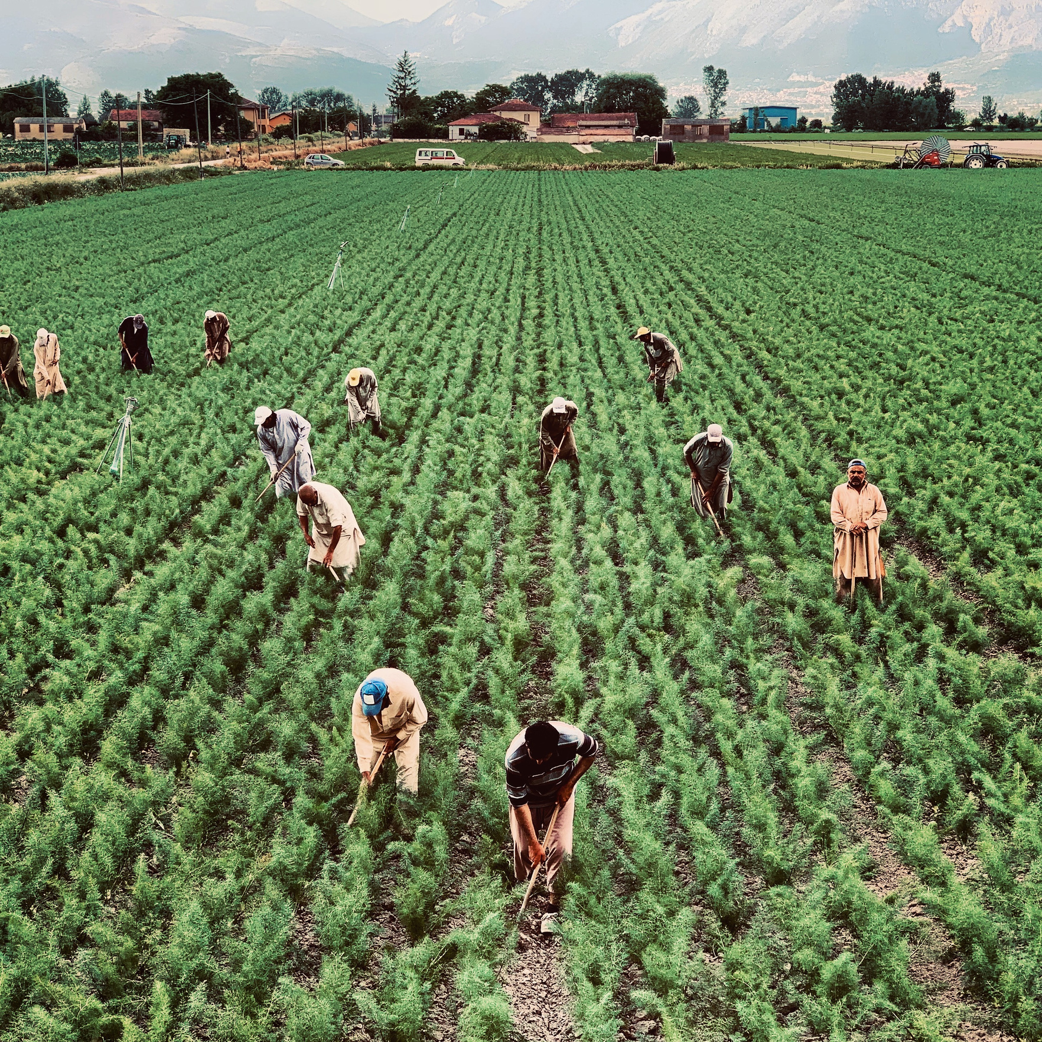
Key Features
04
Weather Forecasting (via OpenWeather API)
Insights & Analytics (crop & soil data)
Schedules & Reminders
Notifications (email via EmailJS + dashboard alerts)
Knowledge Badges (learning & achievements)
Role-Based Dashboard (User vs Admin)

Slide 5
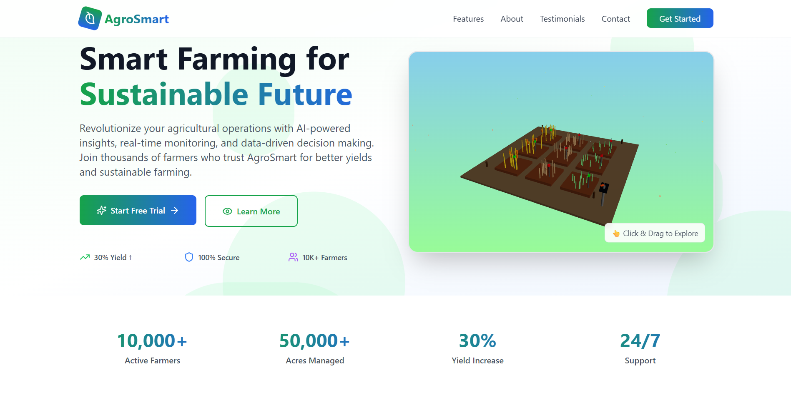
www.agrosmart.me
05

Slide 6
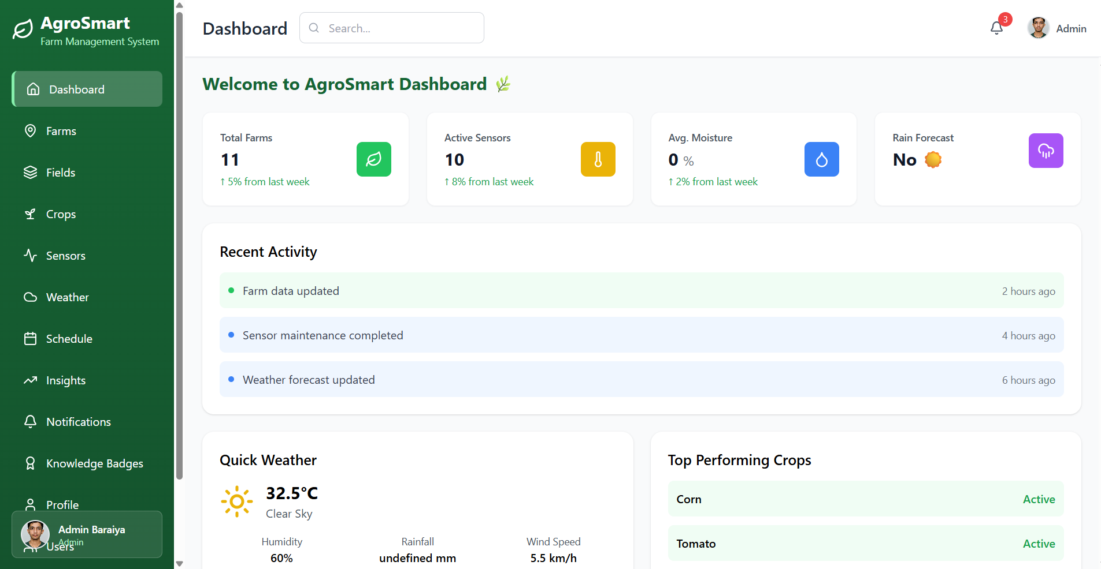
www.agrosmart.me
06

Slide 7
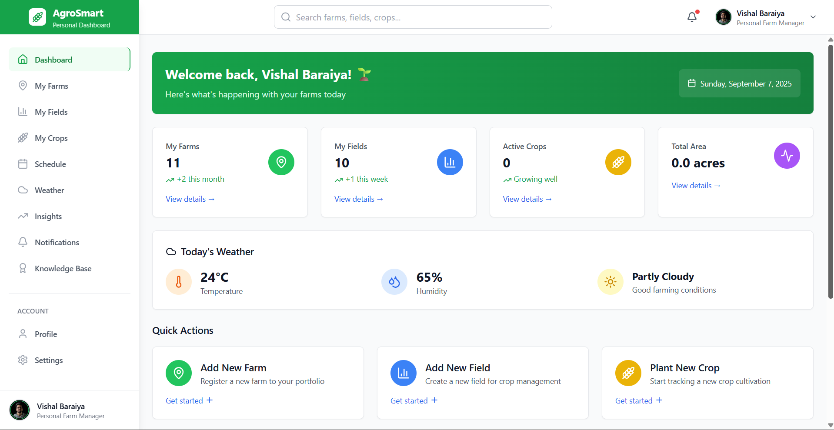
www.agrosmart.me
07

Slide 8
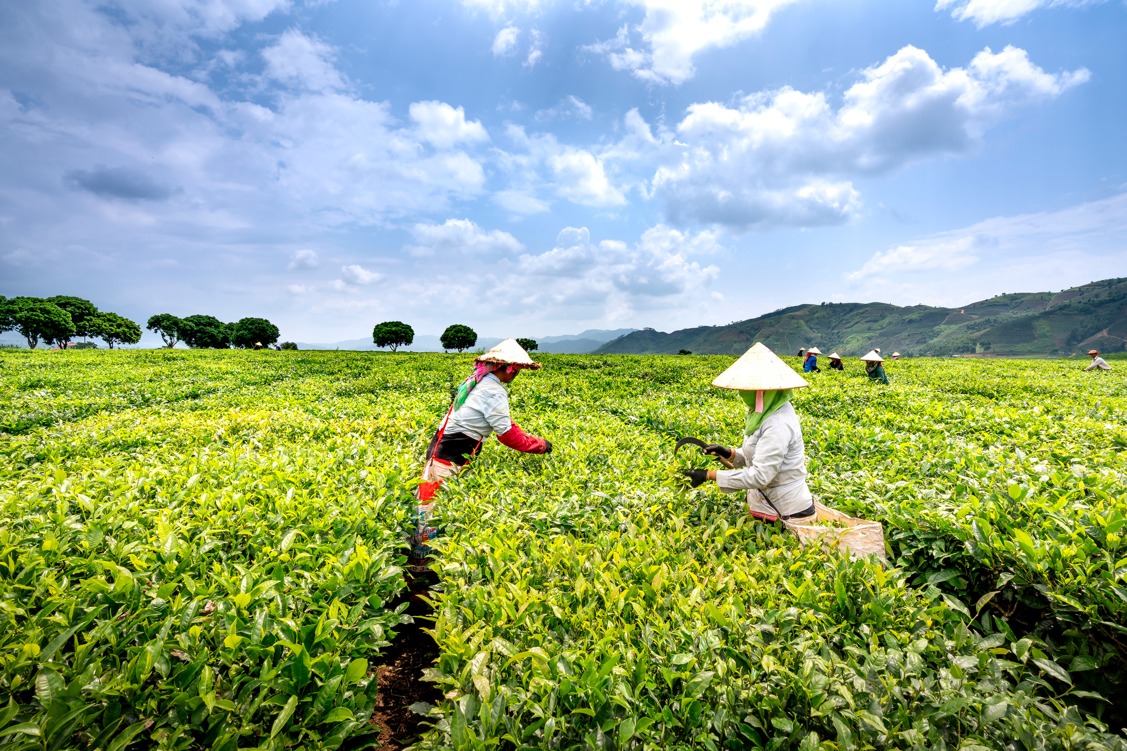
08
User Dashboard
Admin Dashboard
Workflow / Use Case
Dashboard Overview
Weather Page
Insights Page
Notifications Page
Schedules Page
Manage Users
Manage Crops / Farms
Approve / Send Notifications
Analytics Panel
→ Farmer Login → Check Weather
→ Add Crop Schedule
→ Get Notification
→ Track Progress via Insights.

Slide 9
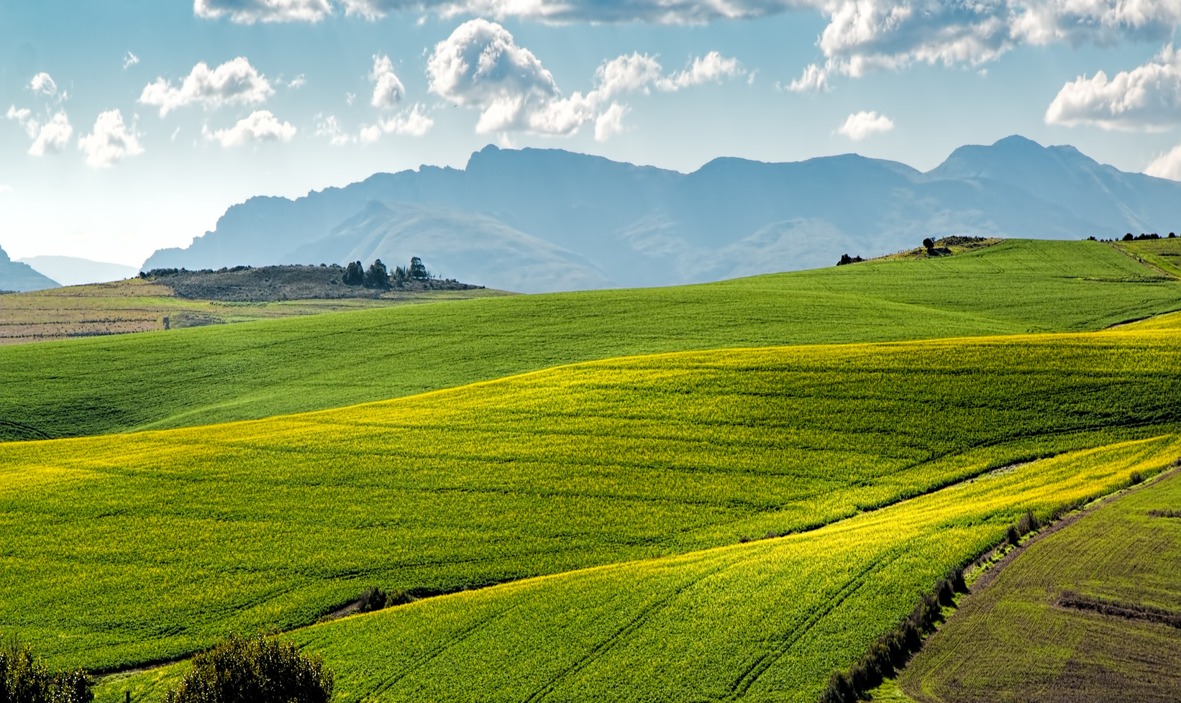
Future Enhancements
Mobile App version
AI-based crop disease detection
Integration with IoT sensors (soil, irrigation)
Multi-language support
Benefits
Real-time data for farmers
Better crop management & yield
Cost savings through optimization
Easy-to-use web app
github.com/mr-baraiya/AgroSmart
www.agrosmart.me
09

Slide 10
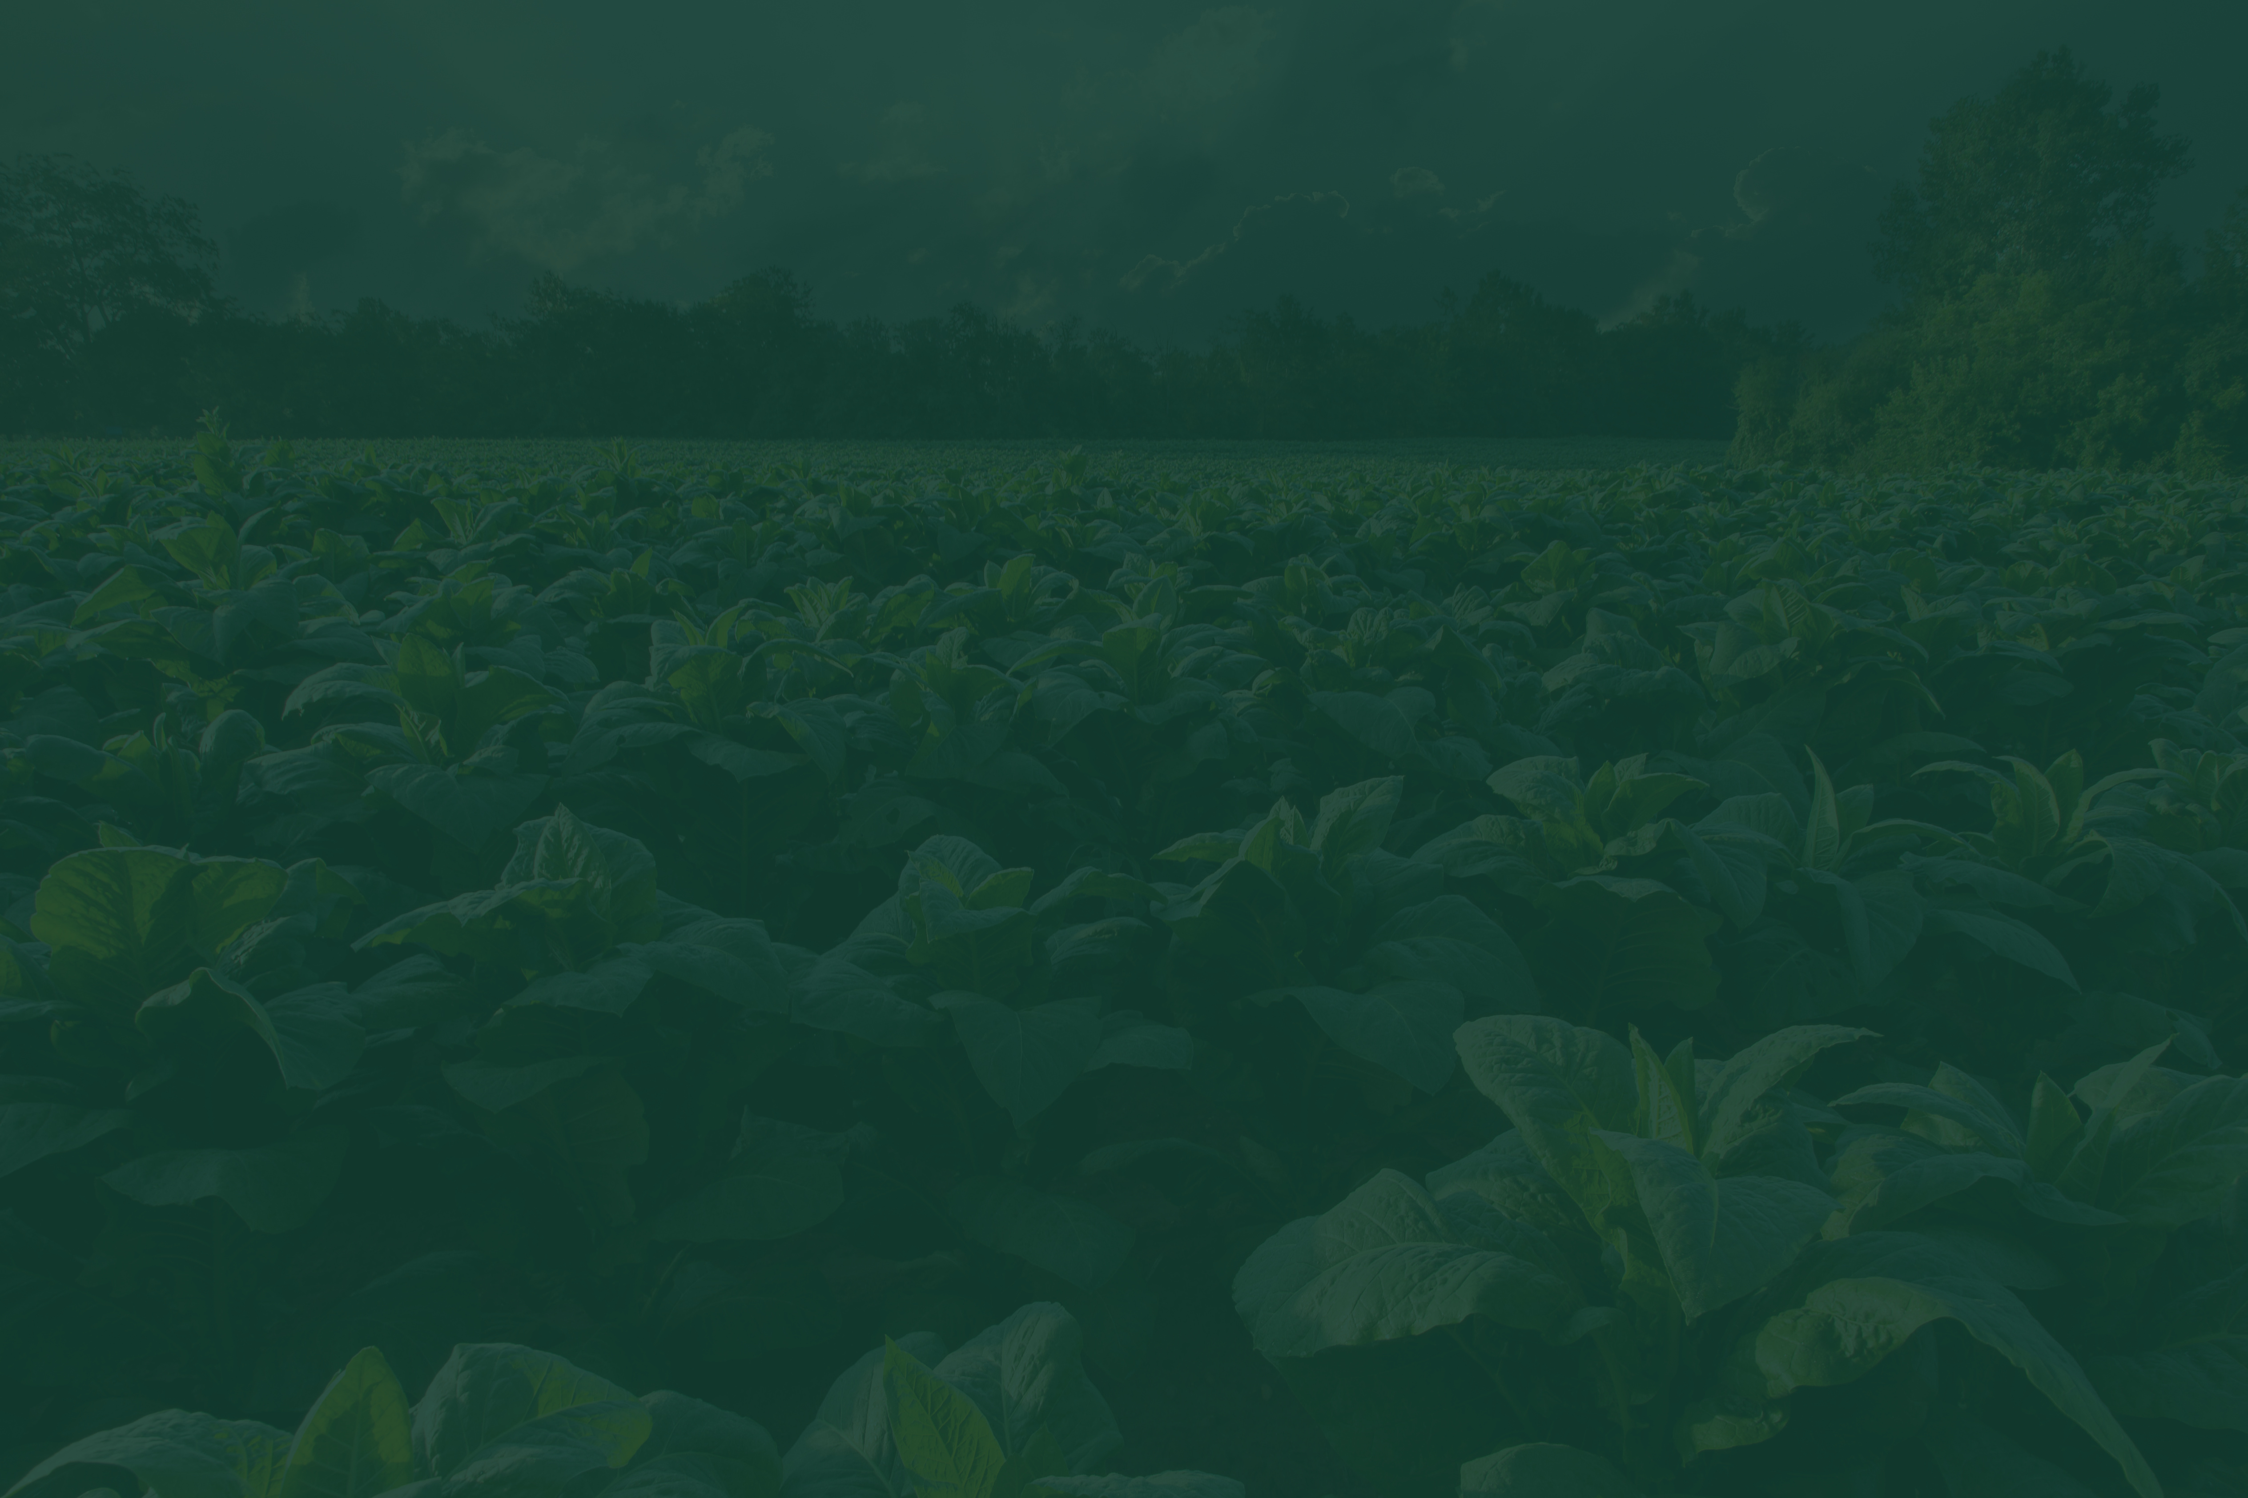



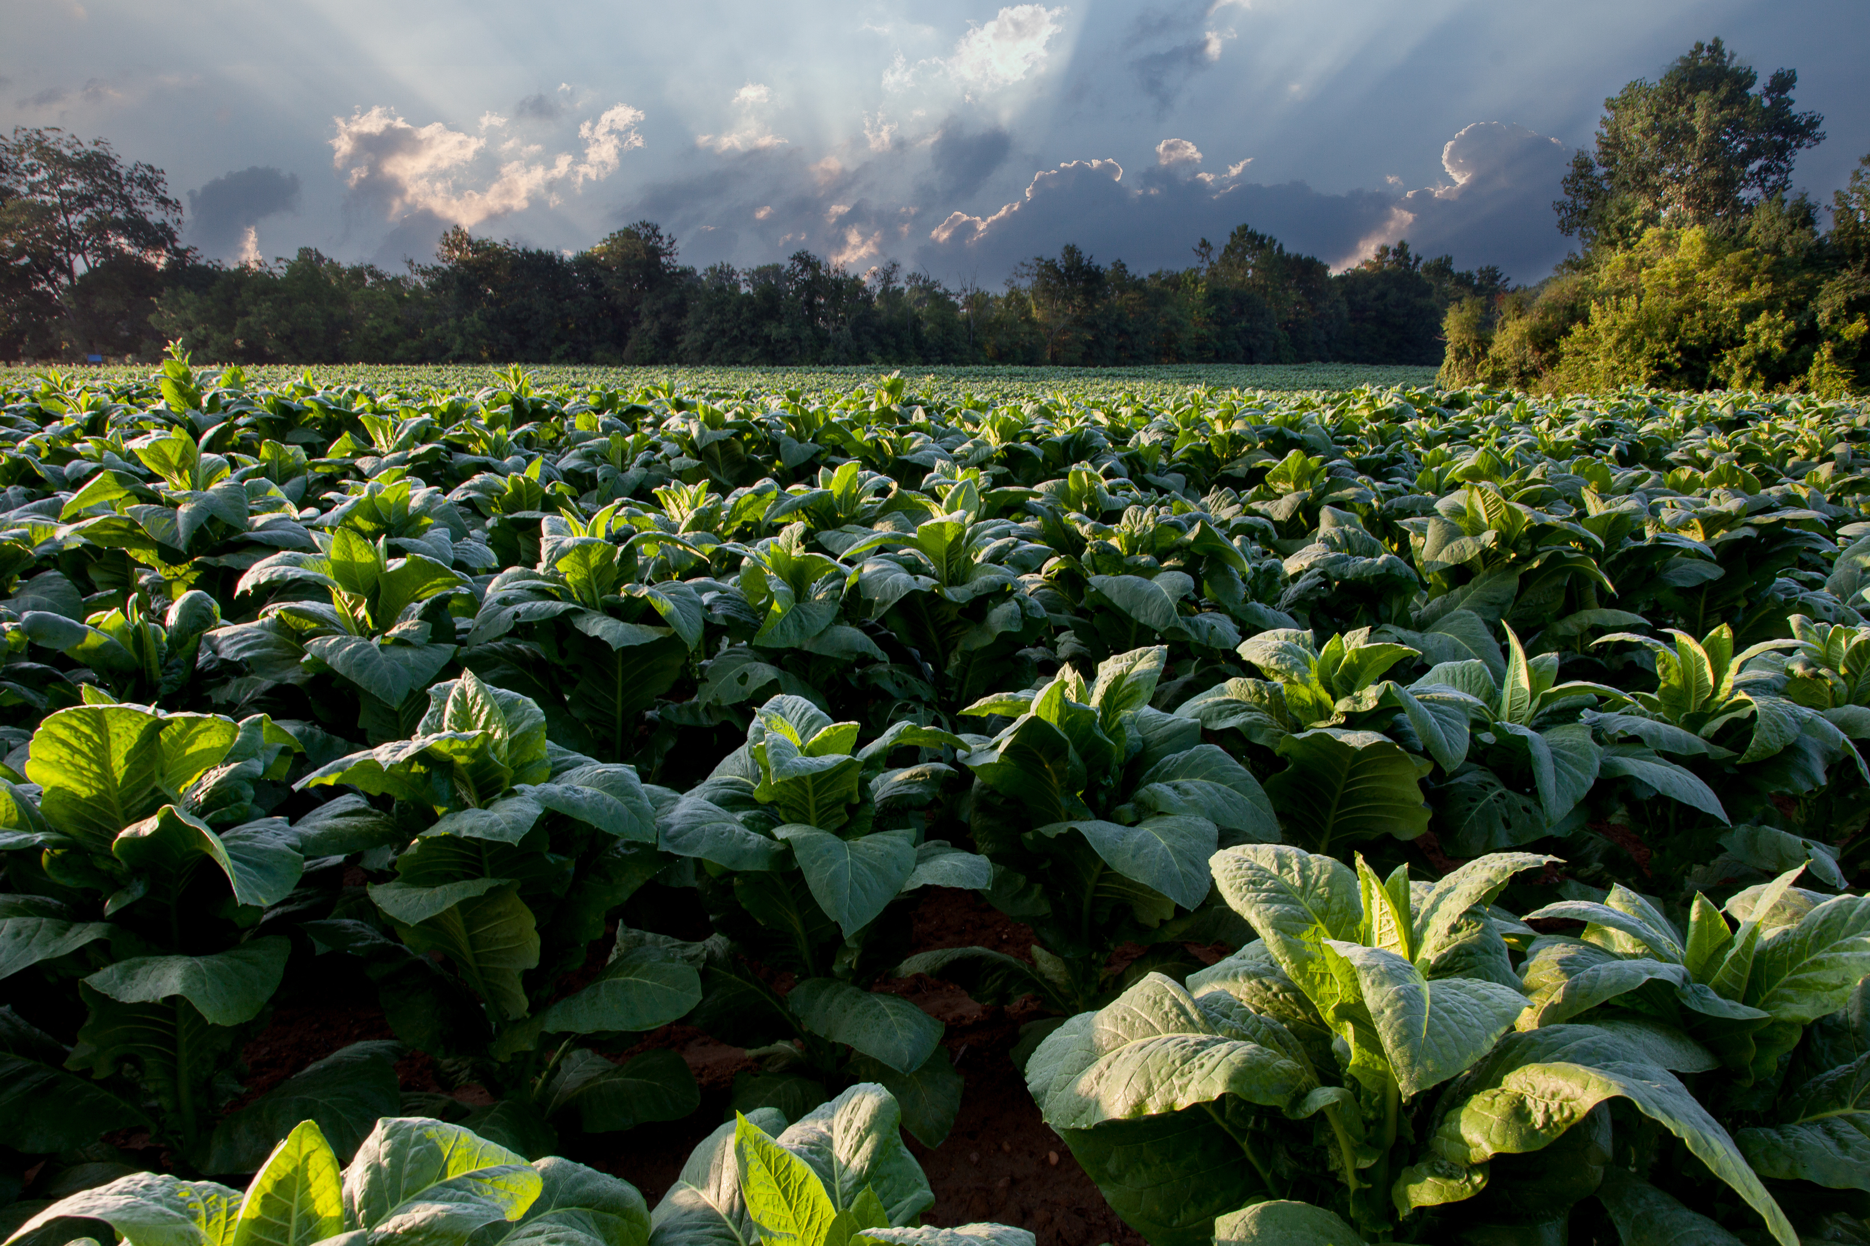
Thank You!
+91 7383359679
www.agrosmart.me
baraiyavishalbhai32@gmail.com

